Slide 1

Stock Data Analysis Report An Exploratory, Statistical, and Risk-Based Analysis
Umme Sabura Nishad

Slide 2
Objectives
Analyse historical stock price and volume data
Extract statistical insights on stock behaviour
Perform Exploratory Data Analysis (EDA) to understand data distribution, trends, and anomalies
Perform risk analysis using VaR and Volatility
Support informed investment decisions

Slide 3
Dataset Overview
Data Fields: Open, High, Low, Close, Adj Close, Volume, MS%change
Derived Variables:
Price_Change = Close - Open
Price_Change_% = ((Close - Open) / Open) * 100
Price_Range = High − Low (intraday range)
Gap = Open − Previous Close (overnight market gap)
Volatility5 = 5-day rolling standard deviation of MS%change

Slide 4

Methodology
Data Preprocessing: datetime conversion, missing data handling, feature engineering
Analysis: descriptive stats, correlation, visualisation
Risk Analysis: Var and Maximum Drawdown

Slide 5
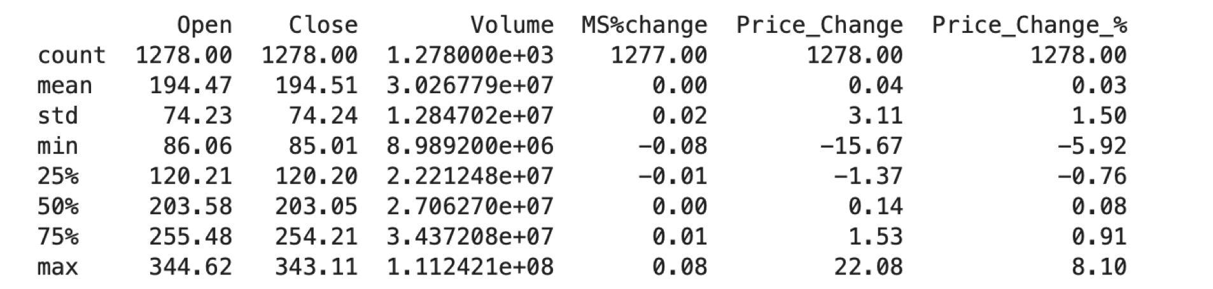
Descriptive Statistics

Slide 6
Key Analysis
Price Behavior (Open & Close): Average opening and closing prices (~$194) are nearly identical, indicating minimal overnight gaps. A standard deviation of approximately $74 and a price range from $85 to $344 indicate moderate volatility and long-term price growth.
Trading Volume: The stock trades about 30 million shares daily on average, with occasional spikes over 111 million shares, often during news-driven events. The volume distribution is right-skewed, suggesting frequent moderate activity and rare surges.
Daily Returns (MS%change): The mean daily return is close to zero with low volatility (std ≈ 0.02), typical for a mature and stable stock. This reflects efficient market behavior with minor daily fluctuations.
Price Change & % Movement: Average daily price change is minimal (~$0.04), but can swing between –$15.67 and +$22.08, showing potential for sharp moves. On a percentage basis, typical changes hover around ±1.5%, but can reach ±8% on volatile days.

Slide 7
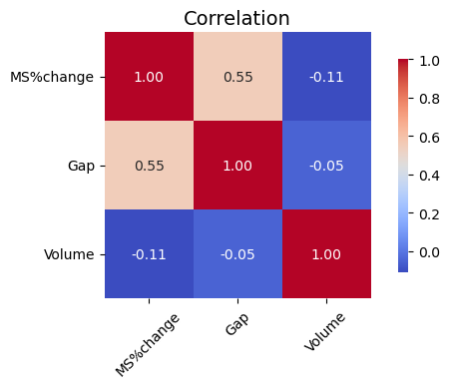
Correlation Insights

Slide 8
Interpretations
MS%change and Gap (0.55): There is a moderately strong positive correlation between the overnight price jump (Gap) and the daily return (MS%change). This means when the stock price opens significantly different from the previous day’s close, it tends to have a substantial impact on the day’s percentage return. The overnight market news or events reflected in the Gap have a strong influence on daily price movements.
MS%change and Volume (-0.11): The negative correlation between Volume and daily returns is mild but noticeable. It suggests that days with higher trading volume tend to correspond with slightly negative returns. This may imply that large volumes often occur during sell-offs or price declines, possibly due to increased investor activity during market downturns or periods of volatility.
Gap and Volume (-0.0511): The small negative correlation here indicates that overnight price jumps are not strongly related to the amount of trading volume. Volume fluctuations tend to be independent of overnight price changes.

Slide 9
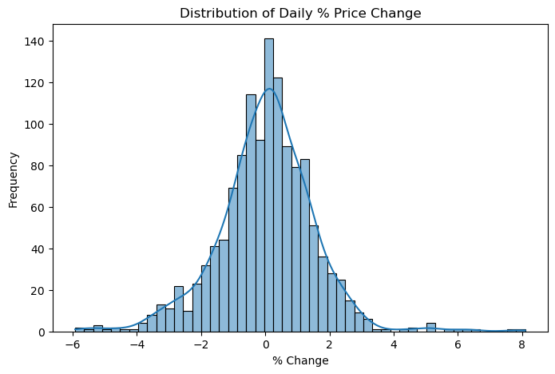
Price Movement Distribution
Central Tendency: Most daily price changes hover near 0%, indicating stable day-to-day behavior.
Shape & Spread: The distribution is roughly normal, but with fat tails → large swings happen more often than a perfect bell curve would suggest.
Investor Implications: While calm days dominate, rare, sharp moves can occur due to news or volatility spikes — important for risk management.
Risk & Volatility: The curve confirms non-negligible volatility, reinforcing the need to account for unexpected price jumps in strategy and modeling.

Slide 10

Risk Analysis
Value at Risk (VaR)
VaR (95%) ≈ -2.68%
Value at Risk (VaR) indicates that there is only a 5% chance of losing more than 0.03% in a day.
This low value reflects relatively stable daily price fluctuations.
Maximum Drawdown
Maximum Drawdown: -0.40%
Max Drawdown suggests the worst cumulative loss from a peak to trough was -0.40%, pointing to limited historical downside in the analysis period.

Slide 11
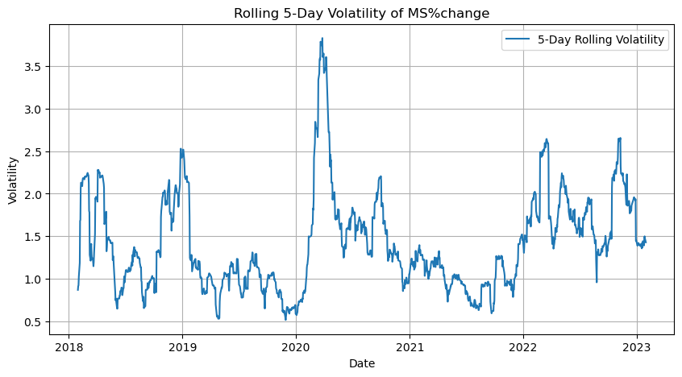
Volatility
Volatility Clustering:
Volatility is not evenly distributed. Instead, it appears in clusters, with periods of high volatility (e.g., early 2020) followed by calmer phases.
This is consistent with the ARCH/GARCH effect in financial time series where volatility tends to group over time.
COVID-19 Spike:
The most significant volatility peak occurred in early 2020, aligning with the onset of the COVID-19 pandemic and the global market crash. Volatility rose above 3.5%, indicating extreme market uncertainty.
Post-2021 Volatility Upticks:
There are several spikes during 2022–2023, likely due to macroeconomic events (e.g., interest rate changes, tech sell-offs).
Low Volatility Periods:
Periods such as late 2019 and mid-2021 showed low volatility (<1.0%), reflecting more stable market conditions.

Slide 12
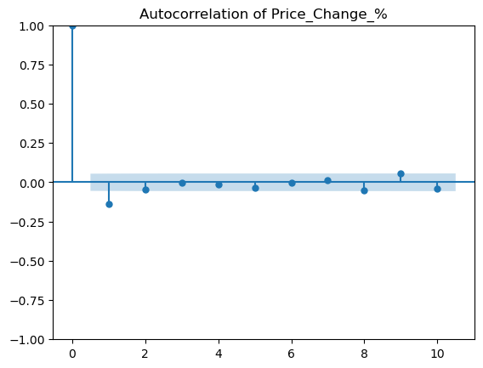
Autocorrelation of Returns
The autocorrelation function (ACF) plot of daily return percentages shows no statistically significant autocorrelation beyond lag 0. This suggests that returns are largely uncorrelated over time and behave like a white noise process. Such behavior aligns with the random walk hypothesis and implies that short-term momentum or reversal strategies may not be effective for this dataset.

Slide 13
Decision-Making Insights
Trading Strategy Design
Avoid momentum strategies: Weak autocorrelation implies past returns are not predictive.
Monitor overnight gaps: Large opening moves (gap values) are informative for daily performance and should be incorporated into short-term strategies.
Risk Management
Use volatility-adjusted position sizing: Since volatility is clustered, during high-volatility periods, reduce position size to control risk.
Implement stop-loss limits based on historical drawdown (e.g., 0.5% to 1%) to mitigate losses beyond typical behaviour.
Portfolio Construction
Diversify to mitigate fat-tail risk: Heavy tails in return distribution warrant diversification across uncorrelated assets.
Incorporate risk-based allocation: Consider volatility and drawdown data when assigning portfolio weights.

Slide 14
Limitations:
The dataset lacks external variables such as macroeconomic indicators, news sentiment, or technical indicators (e.g., RSI, moving averages).
Linear modeling fails to capture non-linear market behaviour.
Discussion and Recommendations
Future Work:
Include additional variables: sector index, VIX, or Fed interest rate
Apply machine learning models like Random Forest, Gradient Boosting, or LSTM networks
Expand dataset across more stocks and markets

Slide 15

Conclusion
📊 Summary of Findings
Daily returns are mostly stable with minimal overnight gaps.
Volatility clustering observed — high-volatility days tend to follow each other.
Returns show low autocorrelation, consistent with efficient market behavior.
⚠️ Risk Profile
Short-term risk is low, but rare large losses do occur.
Distribution tails highlight the importance of robust risk management.

Slide 16

How the Company Benefits
Data-driven investment decisions for optimal buy/sell timing
Risk management through volatility and stop-loss insights
Trading strategy optimization using key price drivers
Market behavior understanding via trend and seasonality analysis
Scalable, reusable framework for diverse assets
Foundation for advanced AI/ML integration
Increased efficiency by automating analysis
Competitive advantage with early and accurate insights

